Slide 1

Google App Engine Tutorial
Joe Gregorio
Developer Advocate
Google App Engine
Joe Gregorio
Developer Advocate
Google App Engine

Slide 2
Examples
Getting Started

Slide 3
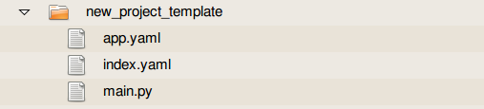
Hello World

Slide 4
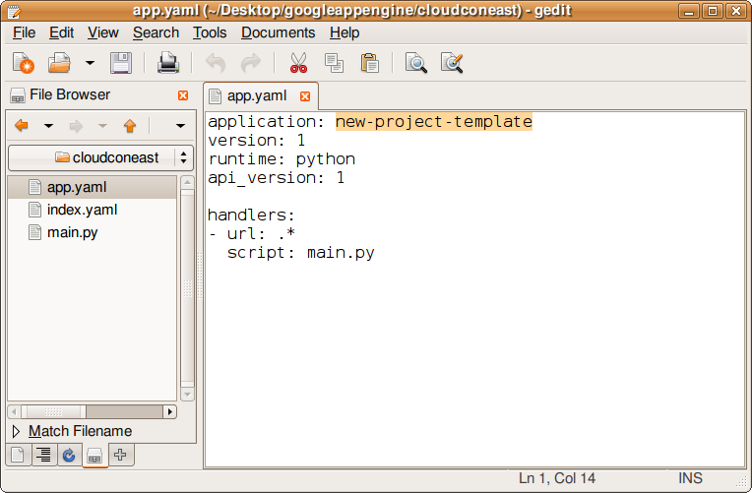
Hello World

Slide 5
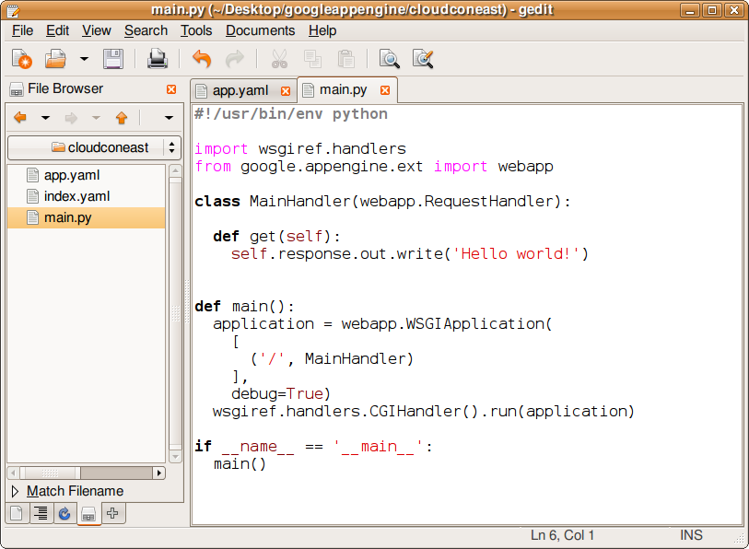
Hello World

Slide 6
Hello World
~/googleappengine/
$ ./dev_appserver.py mydemo

Slide 7
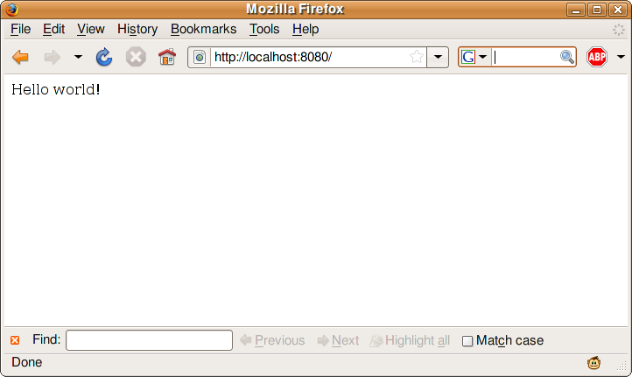
Hello World

Slide 8
Hello World
~/googleappengine/
$ ./appcfg.py update

Slide 9
Examples
Hello World with Templates

Slide 10
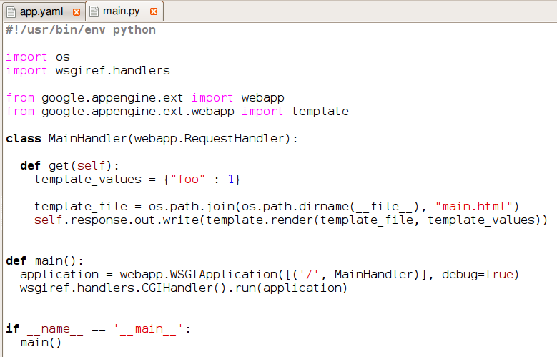
Hello World + Templates

Slide 11
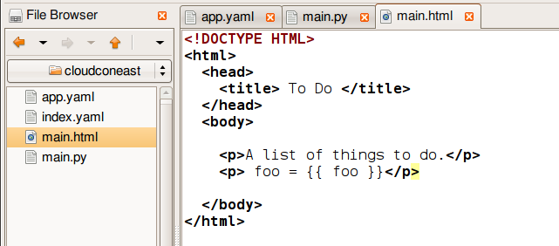
Hello World + Templates

Slide 12
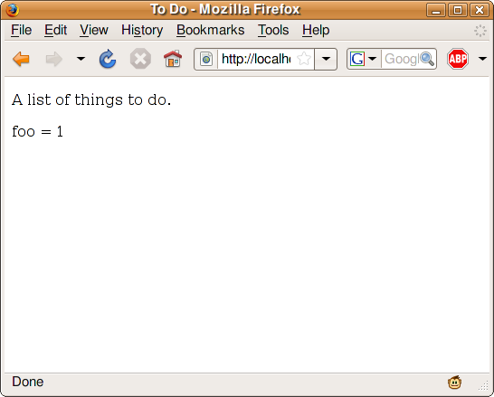
Hello World + Templates

Slide 13
Examples
To Do List

Slide 14
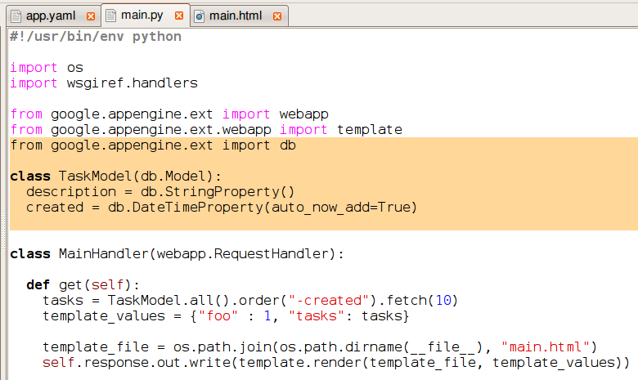
To Do List

Slide 15
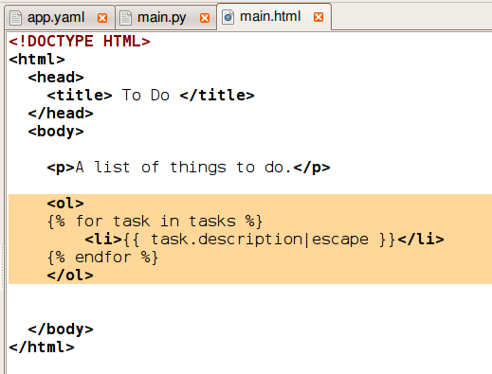
To Do List

Slide 16
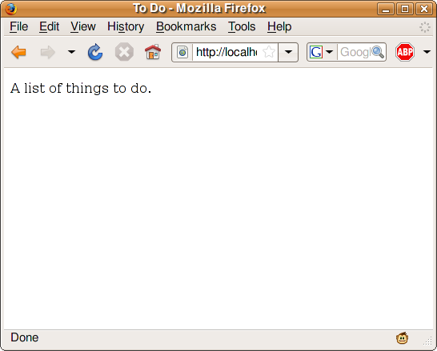
To Do List

Slide 17
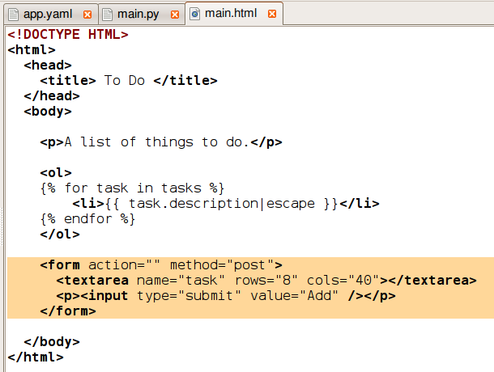
To Do List

Slide 18
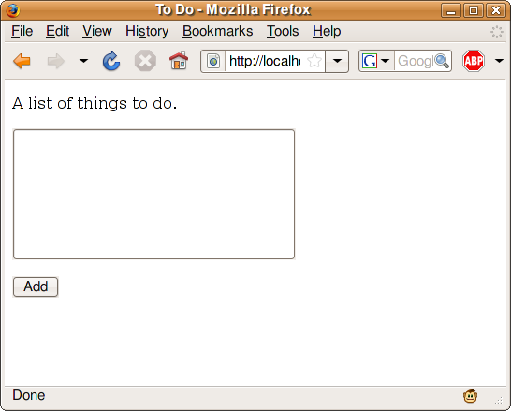
To Do List

Slide 19
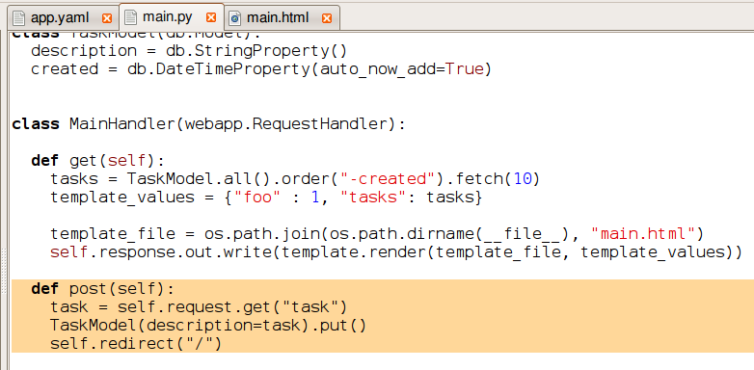
To Do List

Slide 20
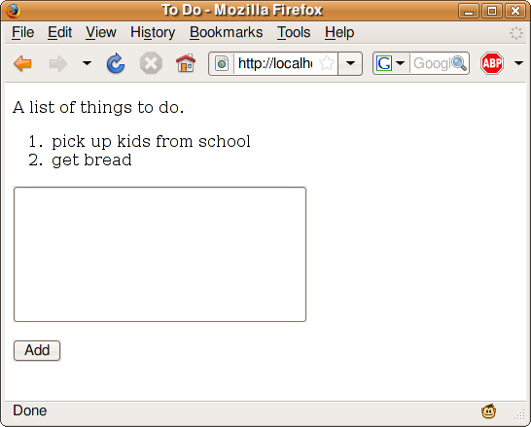
To Do List

Slide 21
Thank You
Questions?

